Slide 1
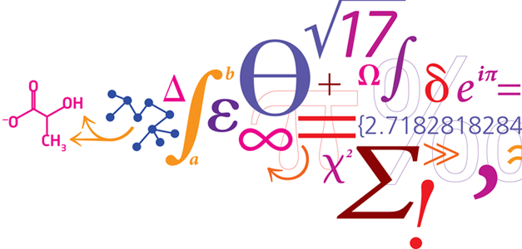

ICSB 2017 Workshop: DD-DeCaF, cobrapy, escher and cameo
A tutorial on metabolic flux modeling using packages from the cobrapy community
Henning Redestig
Nikolaus Sonnenschein
Moritz Beber
Christian Lieven
Notes:
Me: high-level overview of what we do in our group and how we fit in the center’s objectives
The talk will be biased towards the modeling side

Slide 2

NNF Center for Biosustainability

Slide 3
The strain engineering problem
$$$
Commercially viable
Strain
???
$ ☹
Theoretical
maximum
yield (determined
by stoichiometric modeling)
Product yield
???
Growth yield
Notes:
Before I start I would like to go through a little scenario in order to show why is computational strain engineering is useful
…

Slide 4
The problem with traditional metabolic engineering
Commercial:
Product titre > 10 g/L
>25 FTE for >5 years
Cost >$50M
Academic:
Product titre < 100 mg/L
2 FTE for 3 years
Cost $1M
Valley of Death

Slide 5
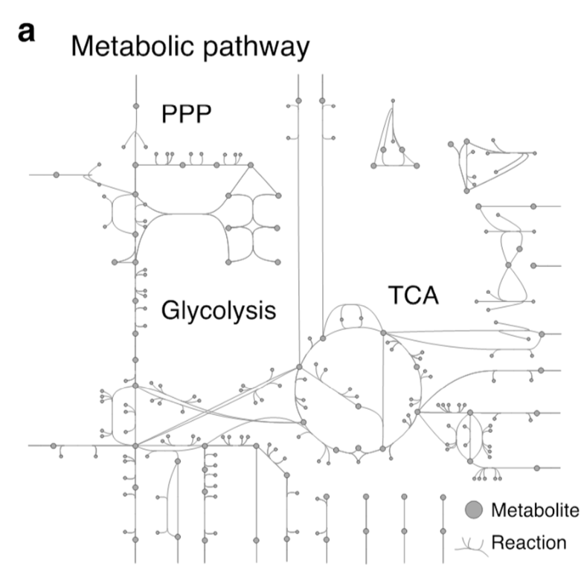
Bridging the valley of death
Lab automation
Commercial:
Product titre > 10 g/L
Cost <$20M
Omics
Systems biology
guided design
Academic:
Product titre < 100 mg/L
2 FTE for 3 years
Cost $1M
Valley of Death

Slide 6
Software tools to be covered in this workshop

Slide 7


Developed by Zachary King

Slide 8
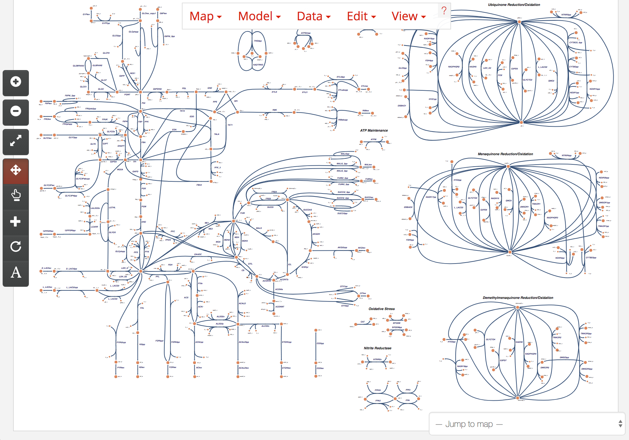

Slide 9

http://opencobra.github.io/cobrapy/

Slide 10

Computer Aided Metabolic Engineering and Optimization of Cell Factories
http://cameo.bio
http://www.biorxiv.org/content/early/2017/06/09/147199 => https://goo.gl/yyWhvs

Slide 11
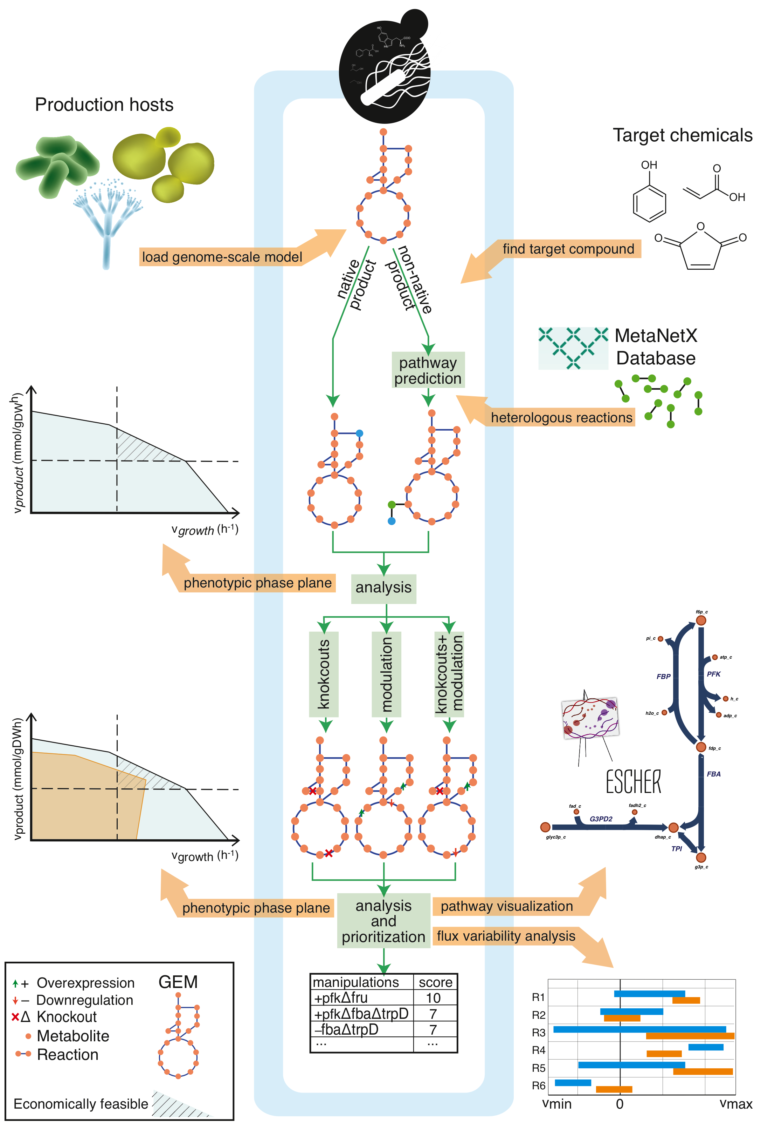
Workflow

Slide 12
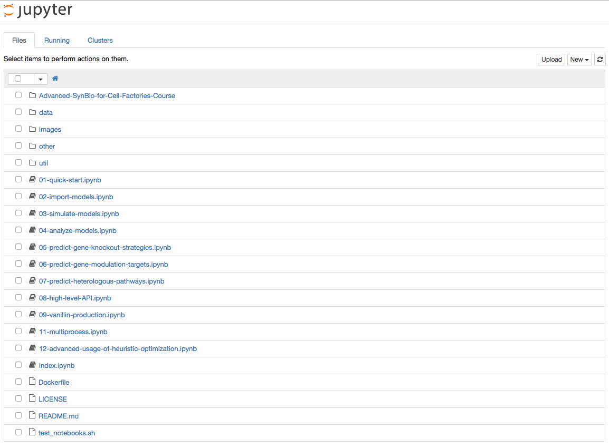
http://try.cameo.bio
http://www.biorxiv.org/content/early/2017/06/09/147199 => https://goo.gl/yyWhvs

Slide 13


H2020: Data-Driven Design of Cell Factories and Communities
http://dd-decaf.eu/
The project has received funding from the European Union’s Horizon 2020 research and innovation programme under grant agreement No 686070

Slide 14
Horizon 2020: Data-Driven Design of Cell Factories and Communities
Notes:
230

Slide 15
Constraint-based modeling

Slide 16
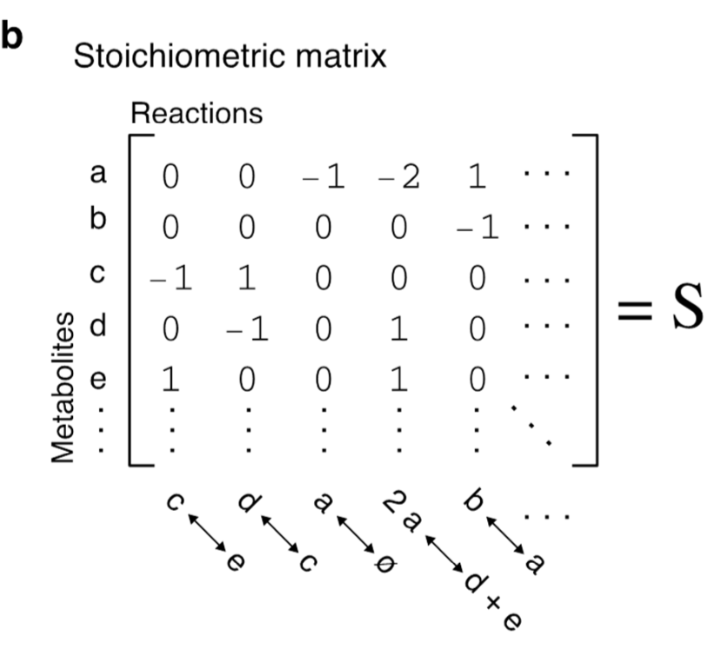
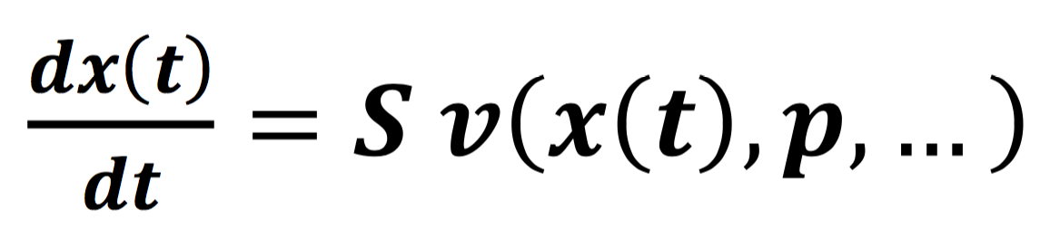
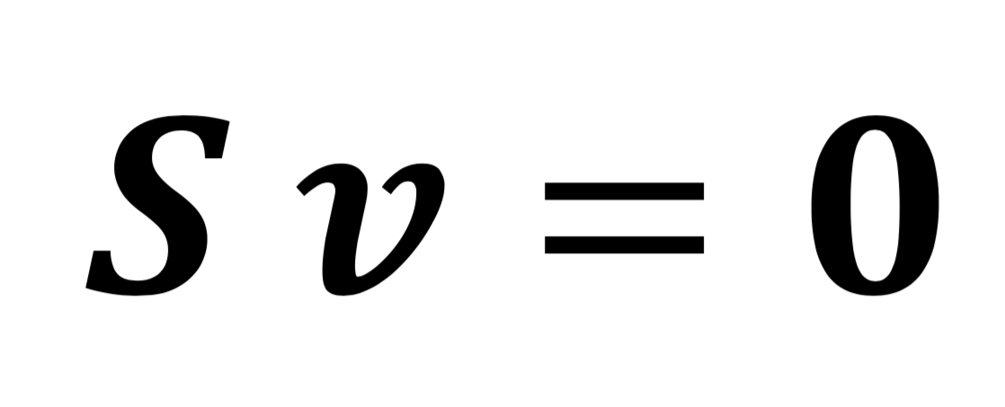
Flux balance analysis: derivation

Slide 17
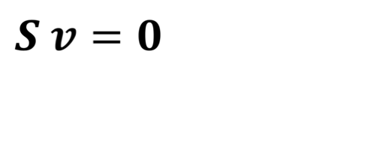

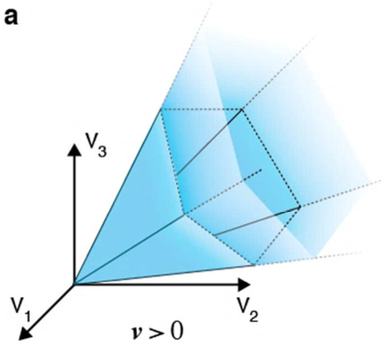
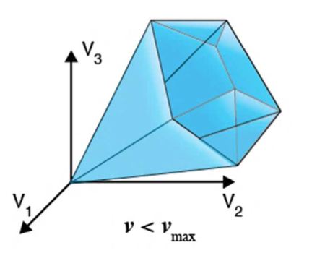
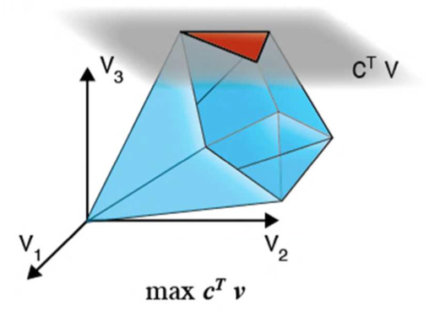
Flux balance analysis: constraints
Following constraints can be superimposed
Mass balance: metabolite production and consumption rates are equal ( )
Thermodynamics: e.g. irreversibility of reactions
Flux capacities: bounds on flux e.g. nutrient uptake rates
Optimize a biological objective (e.g. biomass production)

Slide 18
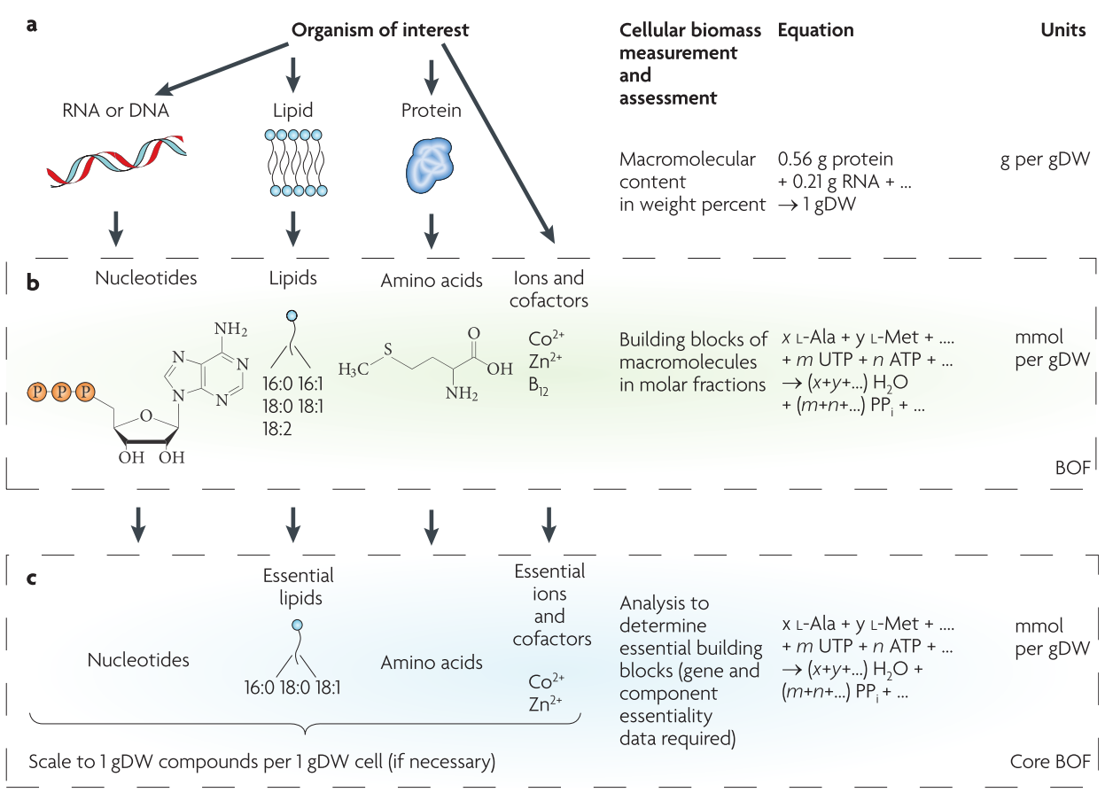
The biomass equation
Feist, A. M., Herrgard, M. J., Thiele, I., Reed, J. L., & Palsson, B. Ø. (2009). Reconstruction of biochemical networks in microorganisms. Nature Reviews Microbiology, 7(2), 129–143. http://doi.org/10.1038/nrmicro1949

Slide 19
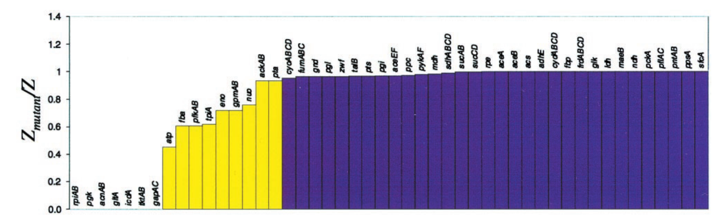
Predict gene essentiality with FBA
Edwards, J. S., & Palsson, B. Ø. (2000). The Escherichia coli MG1655 in silico metabolic genotype: its definition, characteristics, and capabilities. Proceedings of the National Academy of Sciences of the United States of America, 97(10), 5528–5533.

Slide 20
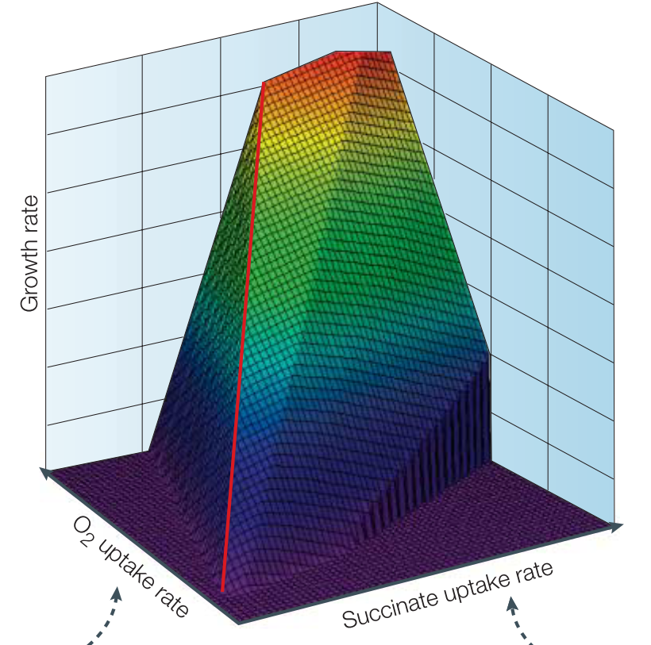

Phenotypic Phase Planes (PPP)

Slide 21
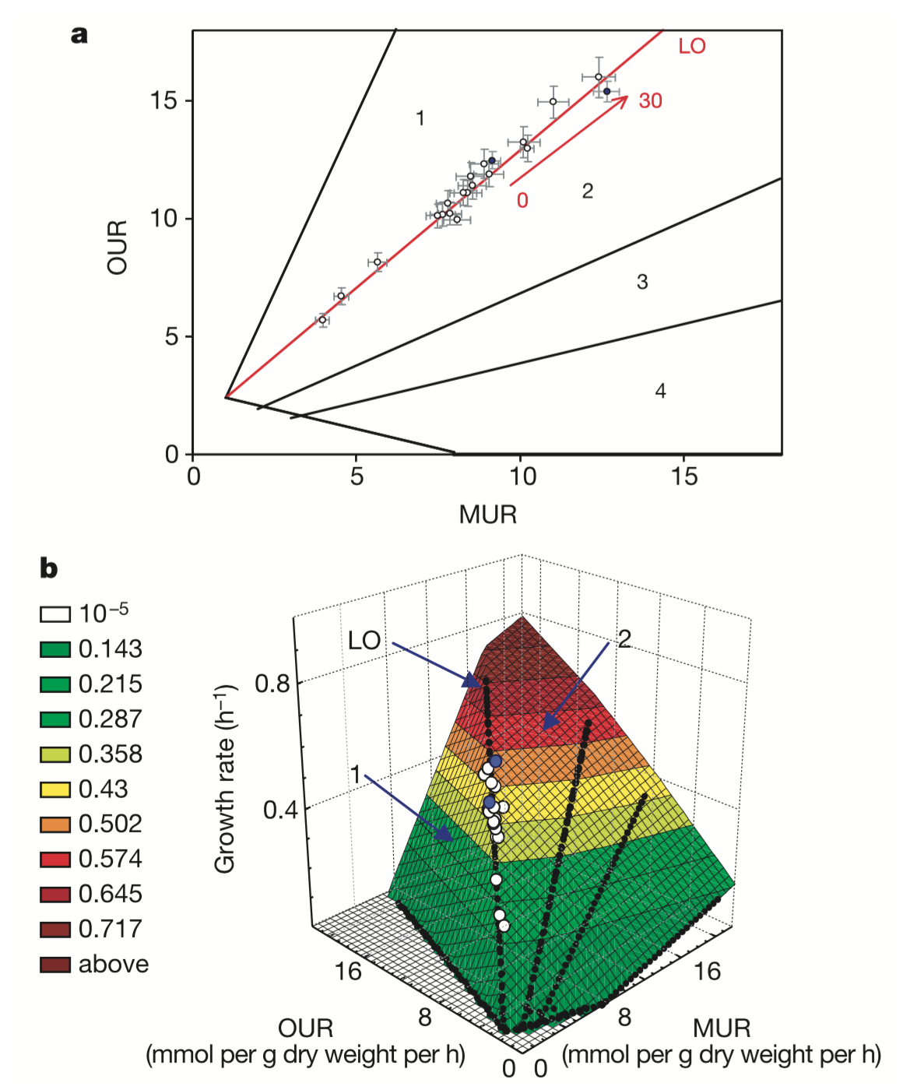
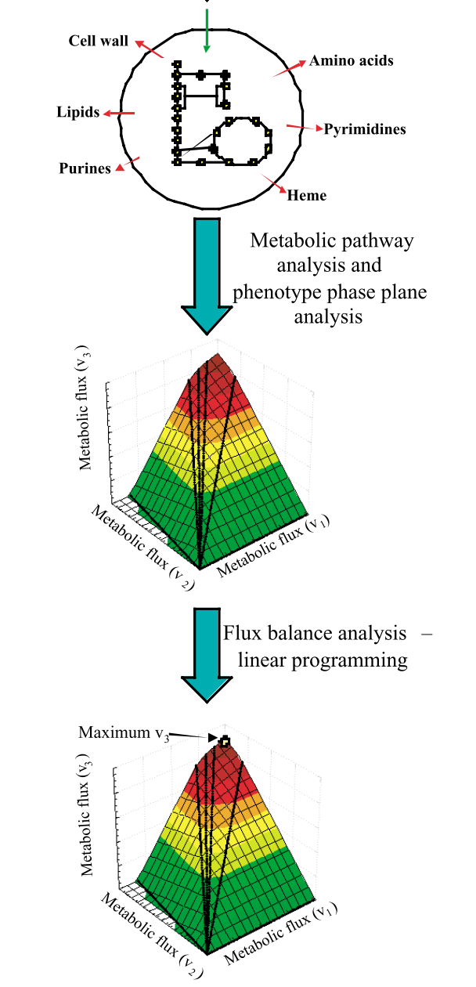
Adaptive laboratory evolution confirms FBA predictions
Phenotypic
Phase
Plane
FBA result
projected
Edwards, J. S., Ibarra, R. U., & Palsson, B. Ø. (2001). In silico predictions of Escherichia coli metabolic capabilities are consistent with experimental data. Nature Biotechnology, 19(2), 125–130. http://doi.org/10.1038/84379
Notes:
Figure 1 Growth of E. coli K-12 on malate. a, The malate–oxygen phenotype phase plane (PPP) Phase 1 is characterized by metabolic futile cycles, whereas phase 2 is characterized by acetate overflow metabolism. The line of optimality (LO, in red) separates phases 1 and 2 (ref. 21.) Data points (open circles) represent malate concentrations ranging from 0.25–3 g l21; and temperatures ranging from 29–37 8C. The two data points in blue represent the starting point (day 0) and endpoint (day 30) of adaptive evolution respectively, at a malate concentration of 2 g l21 and a temperature of 37 8C. These data points represent a span of 500 generations. b, Three-dimensional representation of growth rates. The x and y axes represent the same variables as in a. The z axis represents the cellular growth rate (h21). OUR, oxygen uptake rate; MUR, malate uptake rate.

Slide 22
Adaptive laboratory evolution confirms FBA predictions
Phenotypic
Phase
Plane
Edwards, J. S., Ibarra, R. U., & Palsson, B. Ø. (2001). In silico predictions of Escherichia coli metabolic capabilities are consistent with experimental data. Nature Biotechnology, 19(2), 125–130. http://doi.org/10.1038/84379
Notes:
Figure 1 Growth of E. coli K-12 on malate. a, The malate–oxygen phenotype phase plane (PPP) Phase 1 is characterized by metabolic futile cycles, whereas phase 2 is characterized by acetate overflow metabolism. The line of optimality (LO, in red) separates phases 1 and 2 (ref. 21.) Data points (open circles) represent malate concentrations ranging from 0.25–3 g l21; and temperatures ranging from 29–37 8C. The two data points in blue represent the starting point (day 0) and endpoint (day 30) of adaptive evolution respectively, at a malate concentration of 2 g l21 and a temperature of 37 8C. These data points represent a span of 500 generations. b, Three-dimensional representation of growth rates. The x and y axes represent the same variables as in a. The z axis represents the cellular growth rate (h21). OUR, oxygen uptake rate; MUR, malate uptake rate.

Slide 23
Success of the field
A Bordbar, JM Monk, ZA King, BO Palsson
Nature Reviews Genetics 15 (2), 107-120

Slide 24
Workshop details

Slide 25
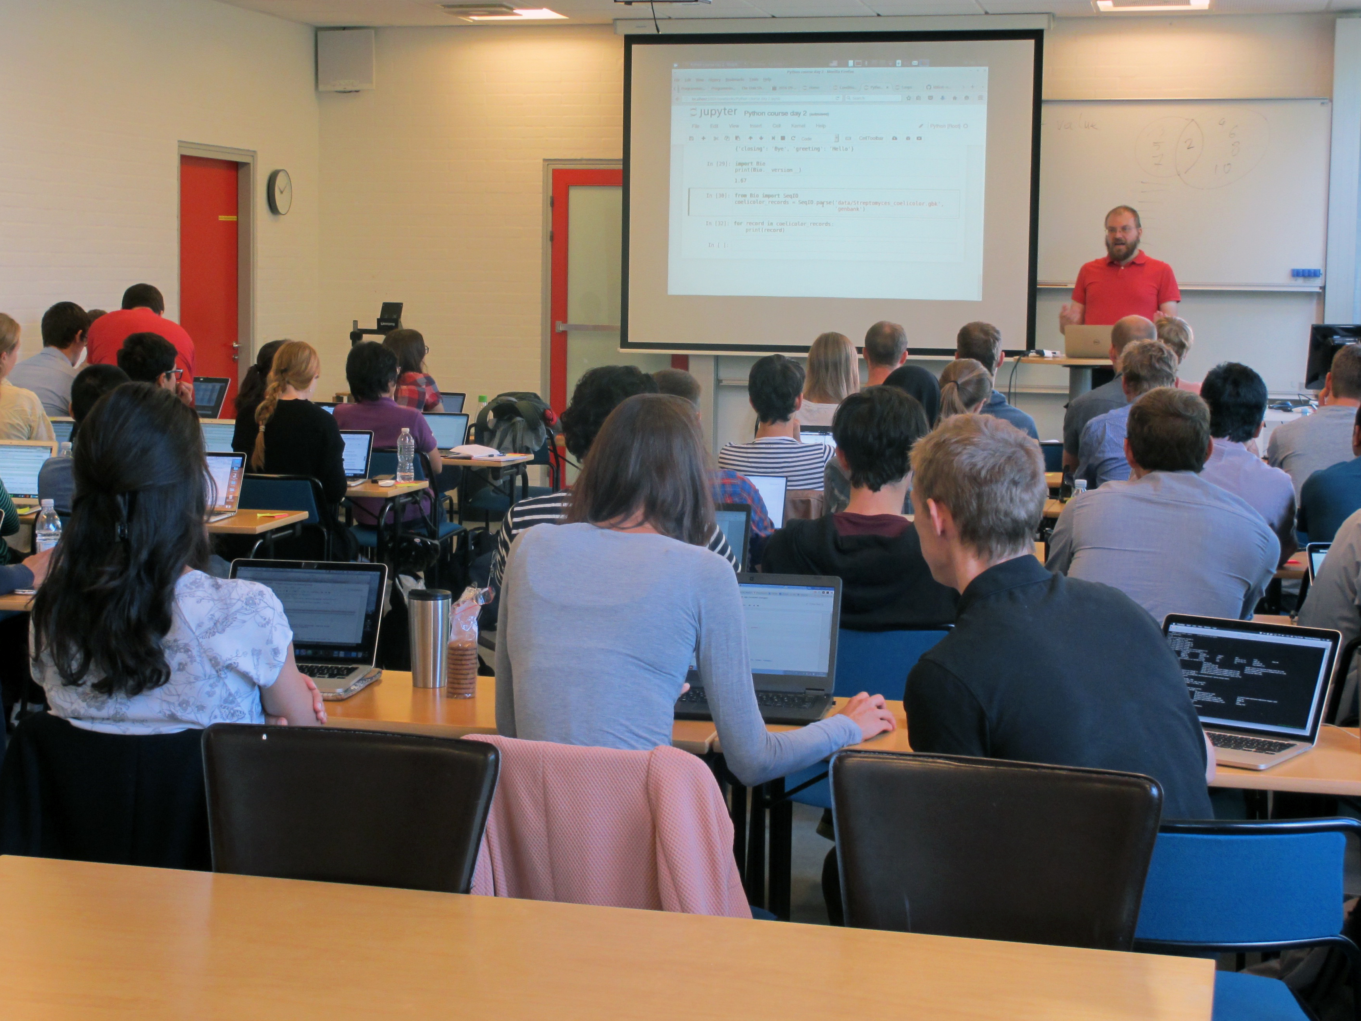
Software carpentry + Computational cell factory engineering course (2016)

Slide 26
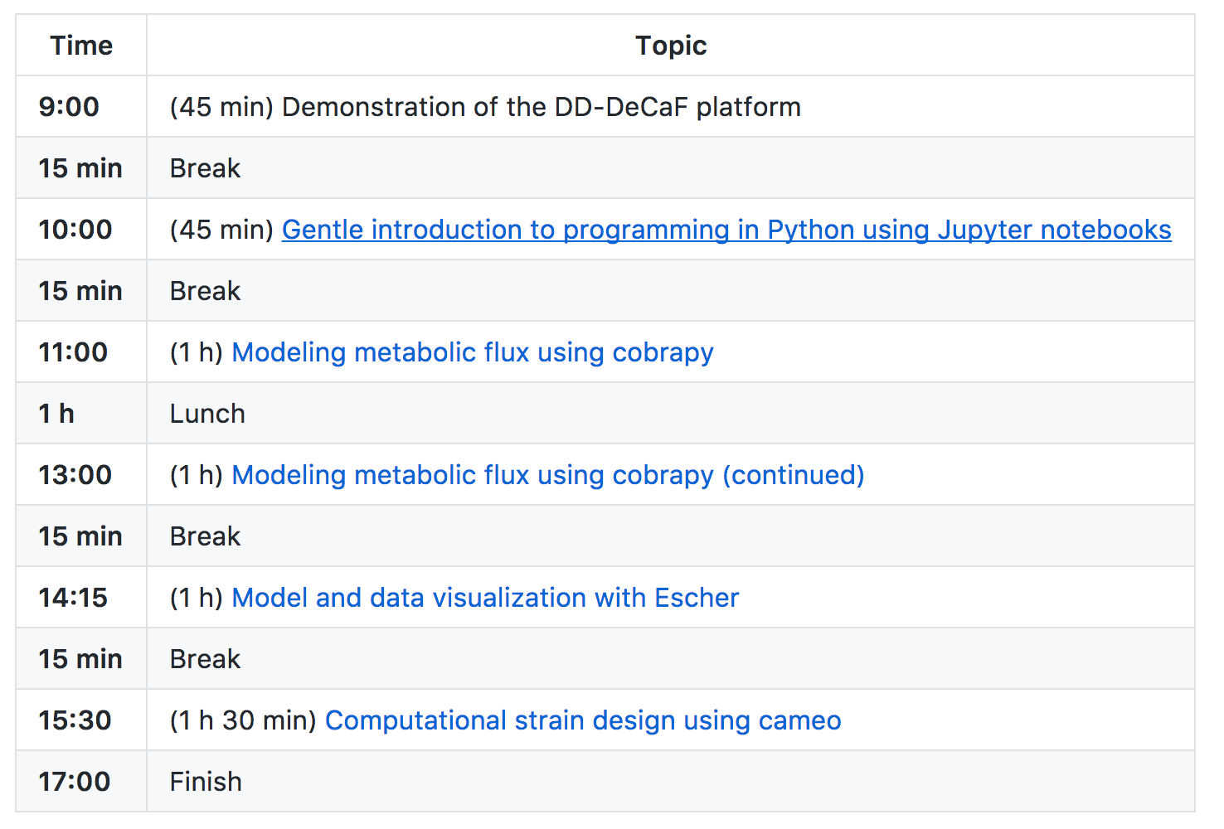
Workshop schedule

Slide 27
Workshop materials and server
Workshop materials
https://github.com/DD-DeCaF/icsb-tutorial
Workshop JupyterHub
No installation hassle of software
https://workshop.dd-decaf.eu
You will need to create a GitHub account if you don’t already have one

